Slide 1
Clan
10310CS 540500 Compilers for Embedded Systems
陳衍昊 Yen-Hao Chen
yhchen@cs.nthu.edu.tw

Slide 2
Data Flow of Polyhedral IR
Clan
Extract polyhedral IR from source code (C/C++)
Candl
Compute dependences from polyhedral IR
……… (Lots efforts on optimizing polyhedral IR)
CLoog
Generate syntactic code from optimized polyhedral IR

Slide 3
Clan
Chunky Loop Analyzer
A translator from a given program representation to another representation
Input
C grammar (C, C++, C# or Java)
Output
Polyhedral intermediate representation (IR)
The input of Candl, the dependences analyzer

Slide 4
Demon
Clan 0.8.0
Latest release version (2014-06-03)
Build & Run
http://icps.u-strasbg.fr/people/bastoul/public_html/development/clan/

Slide 5
We’ve heard lots of Polyhedral
What is the relationship exactly between polyhedral model and my C/C++ code?
How does my statement become a polyhedral?
$$\left[\begin{matrix}\begin{matrix}\begin{matrix}\begin{matrix}1 & 0\end{matrix} & \begin{matrix}0 & −2\end{matrix}\end{matrix} \\ \begin{matrix}\begin{matrix}−1 & 0\end{matrix} & \begin{matrix}1 & 0\end{matrix}\end{matrix}\end{matrix} \\ \begin{matrix}\begin{matrix}\begin{matrix}0 & 1\end{matrix} & \begin{matrix}0 & −2\end{matrix}\end{matrix} \\ \begin{matrix}\begin{matrix}0 & −1\end{matrix} & \begin{matrix}1 & 0\end{matrix}\end{matrix}\end{matrix}\end{matrix}\right]\left(\begin{matrix}\begin{matrix}i \\ j\end{matrix} \\ \begin{matrix}N \\ 1\end{matrix}\end{matrix}\right)≥\left(\begin{matrix}\begin{matrix}0 \\ 0\end{matrix} \\ \begin{matrix}0 \\ 0\end{matrix}\end{matrix}\right)$$
$$for \left(i=0;i≤N;i++\right)\{ \\ for (j=0;j≤i−1;j++)\{ \\ a\left[i\right]\left[i\right]−=a\left[i\right]\left[j\right]; \\ \} \\ a\left[i\right]\left[i\right]=sqrt\left(a\left[i\right]\left[i\right]\right); \\ for (j=i+1;j≤N;j++)\{ \\ for (k=1;k≤i−1;k++)\{ \\ a\left[j\right]\left[i\right]−=a\left[j\right]\left[k\right]∗a\left[i\right]\left[k\right]; \\ \} \\ a\left[j\right]\left[i\right] /=a\left[i\right]\left[i\right]; \\ \} \\ \}$$
Iteration domain
$$θ\left(\begin{matrix}\begin{matrix}i \\ j\end{matrix} \\ \begin{matrix}N \\ 1\end{matrix}\end{matrix}\right)=\left[\begin{matrix}\begin{matrix}\begin{matrix}1 & 0\end{matrix} & \begin{matrix}0 & 0\end{matrix}\end{matrix} \\ \begin{matrix}\begin{matrix}0 & 1\end{matrix} & \begin{matrix}0 & 0\end{matrix}\end{matrix}\end{matrix}\right]\left(\begin{matrix}\begin{matrix}i \\ j\end{matrix} \\ \begin{matrix}N \\ 1\end{matrix}\end{matrix}\right)$$
Scattering function
$$F_{A}\left(\begin{matrix}\begin{matrix}i \\ j\end{matrix} \\ \begin{matrix}N \\ 1\end{matrix}\end{matrix}\right)=\left[\begin{matrix}\begin{matrix}\begin{matrix}1 & 0\end{matrix} & \begin{matrix}0 & 0\end{matrix}\end{matrix} \\ \begin{matrix}\begin{matrix}1 & 0\end{matrix} & \begin{matrix}0 & 0\end{matrix}\end{matrix}\end{matrix}\right]\left(\begin{matrix}\begin{matrix}i \\ j\end{matrix} \\ \begin{matrix}N \\ 1\end{matrix}\end{matrix}\right)$$
Access functions

Slide 6
Polyhedral Representation of Programs

Slide 7
Prerequisites
Basics of Affine Geometry - http://www.cis.upenn.edu/~cis610/geombchap2.pdf
For-loop construction in C program
Affine expression (linear expression)
Matrix-vector multiply
$$for \left(i=0;i≤N;i++\right) \\ for (j=0;j≤N;j++) \\ A\left[i\right]\left[j\right]=B\left[i\right]\left[j\right]+C\left[i\right]\left[j\right];$$
$A\left[ i \right]$ //linear, affine $A\left[ i+j−1 \right]$ //linear, affine $A\left[ i∗j \right]$ //non-linear, not affine $A\left[2∗i+1\right]\left[ i∗j \right]$ //non-linear, not affine $A\left[ B\left[i\right]+1 \right]$ //non-linear, not affine
$$f=c_{0}+\sum_{i=1}^{n}{c_{i}x_{i}}$$
$$\left[\begin{matrix}\begin{matrix}\begin{matrix}\begin{matrix}1 \\ −1\end{matrix} \\ \begin{matrix}0 \\ 0\end{matrix}\end{matrix} & \begin{matrix}\begin{matrix}0 \\ 0\end{matrix} \\ \begin{matrix}1 \\ −1\end{matrix}\end{matrix}\end{matrix} & \begin{matrix}\begin{matrix}\begin{matrix}0 \\ 1\end{matrix} \\ \begin{matrix}0 \\ 1\end{matrix}\end{matrix} & \begin{matrix}\begin{matrix}−2 \\ 0\end{matrix} \\ \begin{matrix}−2 \\ 0\end{matrix}\end{matrix}\end{matrix}\end{matrix}\right]\left(\begin{matrix}\begin{matrix}i \\ j\end{matrix} \\ \begin{matrix}N \\ 1\end{matrix}\end{matrix}\right)=\left(\begin{matrix}\begin{matrix}i−2 \\ −i+N\end{matrix} \\ \begin{matrix}j−2 \\ −j+N\end{matrix}\end{matrix}\right)$$

Slide 8
Affine Expression
A function of one or more variables, $i_{1},i_{2},…,i_{n}$, is affine, if it can be expressed as a sum of a constant, plus constant multiples of the variables. i.e.
Array subscript expressions are usually affine functions involving loop induction variables.
$$f=c_{0}+\sum_{i=1}^{n}{c_{i}x_{i}}$$

Slide 9
Affine Expression
Sometimes, affine functions are called linear functions.
Examples:
$A\left[ i \right]$ affine
$A\left[ i+j−1 \right]$ affine
$A\left[ i∗j \right]$ non-linear; not affine
$A\left[ 2∗i+1, i∗j \right]$ linear, non-linear; not affine
$A\left[ B\left[i\right]+1 \right]$ non-linear; not affine

Slide 10
Program Transformation
Compiler transform program
Optimize for parallelism
Optimize for data locality
Optimize for specific target machine
A powerful model and tools are required
Discover the best transformation
Achieve best performance
Thread 0
Thread 1
Thread 2
Thread 0
Thread 1
$$x=a+b \\ y=c+d \\ z=a∗b$$
$$x=a+b$$
$$y=c+d$$
$$z=a∗b$$
$$x=a+b \\ z=a∗b$$
$$y=c+d$$
Original code
Optimize for parallelism
Optimize for data locality

Slide 11
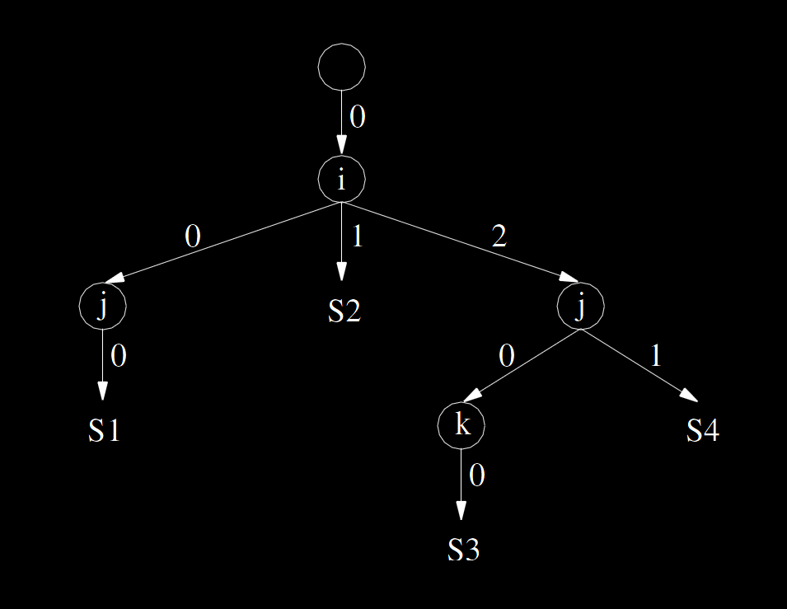
Abstract Syntax Tree (AST)
The traditional internal representation of programs
Each statement is a leaf of abstract syntax tree
$$for \left(i=0;i≤N;i++\right)\{ \\ for (j=0;j≤i−1;j++)\{ \\ a\left[i\right]\left[i\right]−=a\left[i\right]\left[j\right]; \\ \} \\ a\left[i\right]\left[i\right]=sqrt\left(a\left[i\right]\left[i\right]\right); \\ for (j=i+1;j≤N;j++)\{ \\ for (k=1;k≤i−1;k++)\{ \\ a\left[j\right]\left[i\right]−=a\left[j\right]\left[k\right]∗a\left[i\right]\left[k\right]; \\ \} \\ a\left[j\right]\left[i\right] /=a\left[i\right]\left[i\right]; \\ \} \\ \}$$

Slide 12
Abstract Syntax Tree (AST)
Pros.
Similar to classical structure of programs
Easy to construct/reconstruct from/to source code
Cons.
Each statement appears only once even if it is executed many times
Limit program analysis power
Limit program transformation power
Limit program manipulation flexibility

Slide 13
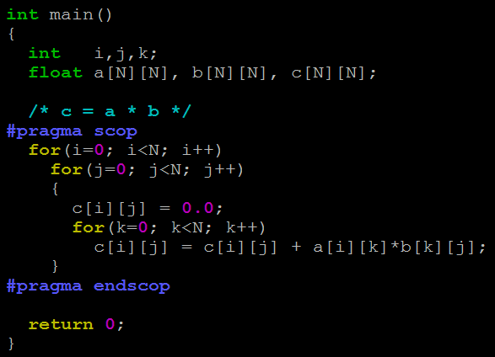
Polyhedral Model
Key aspect of the polyhedral model is to consider statement instances, one execution of a statement
So, polyhedral model deals with loops
Not mean unrolling loops
Too many statement instances to deal with
Not know how many instances on compile time
Static control part (SCop)
A program part that can be represented using the polyhedral model

Slide 14
Iteration Vector
Used to present each statement instance
The ordered list of iterators (Outer to inner)
$$pi=3.14; // S1 \\ for \left(i=0;i≤5;i++\right) \\ A\left[i\right]=pi; // S2 \\ for \left(i=2;i≤N;i++\right) \\ for \left(j=2;j≤N;j++\right) \\ A\left[i\right]=pi; // S3$$
$$Iteration vector: \left( \right) \\ Statement: S1\left( \right) \\ Statement instance: S1\left( \right)$$
$$Iteration vector: \left(i\right) \\ Statement: S2\left(i\right) \\ Statement instance: \\ S2\left(0\right), S2\left(1\right), S2\left(2\right), S2\left(3\right), S2\left(4\right), S2(5)$$
$$Iteration vector: \left(\begin{matrix}i \\ j\end{matrix}\right) \\ Statement: S3\left(\begin{matrix}i \\ j\end{matrix}\right) \\ Statement instance: \\ S3\left(\begin{matrix}2 \\ 2\end{matrix}\right), S3\left(\begin{matrix}2 \\ 3\end{matrix}\right),…,S3\left(\begin{matrix}2 \\ N\end{matrix}\right), …,S3\left(\begin{matrix}3 \\ N\end{matrix}\right),…,S3\left(\begin{matrix}N \\ N\end{matrix}\right)$$

Slide 15
Homogeneous Iteration Vector
The iteration vector with some additional dimensions to represent the parameters and the constant
To manipulate a set of affine constraints easily
They directly call it “iteration vector” for short
$$pi=3.14; // S1 \\ for \left(i=0;i≤5;i++\right) \\ A\left[i\right]=pi; // S2 \\ for \left(i=2;i≤N;i++\right) \\ for \left(j=2;j≤N;j++\right) \\ A\left[i\right]=pi; // S3$$
$$S1\left( \right)$$
$$Iteration vector: \left( \right)$$
$$S2\left(\begin{matrix}i \\ 1\end{matrix}\right)$$
$$Iteration vector: \left(\begin{matrix}i \\ 1\end{matrix}\right)$$
$$S3\left(\begin{matrix}\begin{matrix}i \\ j\end{matrix} \\ \begin{matrix}N \\ 1\end{matrix}\end{matrix}\right)$$
$$Iteration vector\left(\begin{matrix}\begin{matrix}i \\ j\end{matrix} \\ \begin{matrix}N \\ 1\end{matrix}\end{matrix}\right)$$

Slide 16
Polyhedral Representation
Domain matrix
Scattering matrix
Access matrixes
$$\left[\begin{matrix}\begin{matrix}\begin{matrix}\begin{matrix}1 & 0\end{matrix} & \begin{matrix}0 & −2\end{matrix}\end{matrix} \\ \begin{matrix}\begin{matrix}−1 & 0\end{matrix} & \begin{matrix}1 & 0\end{matrix}\end{matrix}\end{matrix} \\ \begin{matrix}\begin{matrix}\begin{matrix}0 & 1\end{matrix} & \begin{matrix}0 & −2\end{matrix}\end{matrix} \\ \begin{matrix}\begin{matrix}0 & −1\end{matrix} & \begin{matrix}1 & 0\end{matrix}\end{matrix}\end{matrix}\end{matrix}\right]\left(\begin{matrix}\begin{matrix}i \\ j\end{matrix} \\ \begin{matrix}N \\ 1\end{matrix}\end{matrix}\right)≥\left(\begin{matrix}\begin{matrix}0 \\ 0\end{matrix} \\ \begin{matrix}0 \\ 0\end{matrix}\end{matrix}\right)$$
$$for \left(i=0;i≤N;i++\right)\{ \\ for (j=0;j≤i−1;j++)\{ \\ a\left[i\right]\left[i\right]−=a\left[i\right]\left[j\right]; \\ \} \\ a\left[i\right]\left[i\right]=sqrt\left(a\left[i\right]\left[i\right]\right); \\ for (j=i+1;j≤N;j++)\{ \\ for (k=1;k≤i−1;k++)\{ \\ a\left[j\right]\left[i\right]−=a\left[j\right]\left[k\right]∗a\left[i\right]\left[k\right]; \\ \} \\ a\left[j\right]\left[i\right] /=a\left[i\right]\left[i\right]; \\ \} \\ \}$$
Iteration domain
$$θ\left(\begin{matrix}\begin{matrix}i \\ j\end{matrix} \\ \begin{matrix}N \\ 1\end{matrix}\end{matrix}\right)=\left[\begin{matrix}\begin{matrix}\begin{matrix}1 & 0\end{matrix} & \begin{matrix}0 & 0\end{matrix}\end{matrix} \\ \begin{matrix}\begin{matrix}0 & 1\end{matrix} & \begin{matrix}0 & 0\end{matrix}\end{matrix}\end{matrix}\right]\left(\begin{matrix}\begin{matrix}i \\ j\end{matrix} \\ \begin{matrix}N \\ 1\end{matrix}\end{matrix}\right)$$
Scattering function
$$F_{A}\left(\begin{matrix}\begin{matrix}i \\ j\end{matrix} \\ \begin{matrix}N \\ 1\end{matrix}\end{matrix}\right)=\left[\begin{matrix}\begin{matrix}\begin{matrix}1 & 0\end{matrix} & \begin{matrix}0 & 0\end{matrix}\end{matrix} \\ \begin{matrix}\begin{matrix}1 & 0\end{matrix} & \begin{matrix}0 & 0\end{matrix}\end{matrix}\end{matrix}\right]\left(\begin{matrix}\begin{matrix}i \\ j\end{matrix} \\ \begin{matrix}N \\ 1\end{matrix}\end{matrix}\right)$$
Access functions

Slide 17
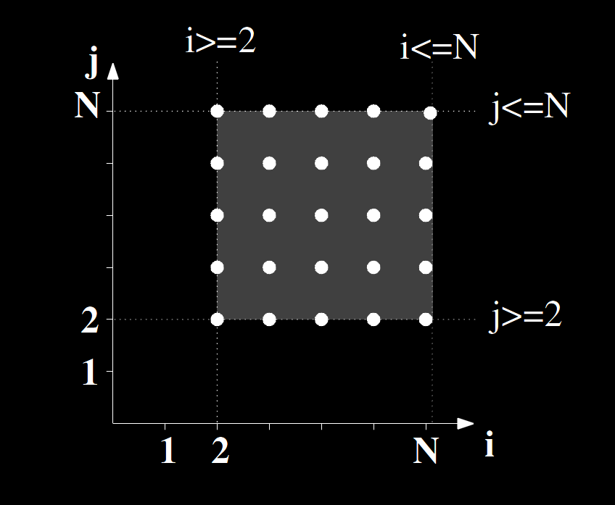
Iteration Domain
The set of all possible values of iteration vector of the statement
A set of affine (linear) constraint only depended on the iterator vector
$$D_{S3}=\left\{\left(i,j\right)∈Z^{2} | 2≤i≤N and 2≤j≤N\right\}$$
$$for \left(i=2;i≤N;i++\right) \\ for \left(j=2;j≤N;j++\right) \\ A\left[i\right]=3.14; // S3$$
$$\left\{\begin{matrix}2≤i≤N \\ 2≤j≤N\end{matrix}\right. \\ ⇒\left\{\begin{matrix}\begin{matrix}i−2≥0 \\ −i+N≥0\end{matrix} \\ \begin{matrix}j−2≥0 \\ −j+N≥0\end{matrix}\end{matrix}\right. \\ ⇒\left[\begin{matrix}\begin{matrix}\begin{matrix}\begin{matrix}1 \\ −1\end{matrix} \\ \begin{matrix}0 \\ 0\end{matrix}\end{matrix} & \begin{matrix}\begin{matrix}0 \\ 0\end{matrix} \\ \begin{matrix}1 \\ −1\end{matrix}\end{matrix}\end{matrix} & \begin{matrix}\begin{matrix}\begin{matrix}0 \\ 1\end{matrix} \\ \begin{matrix}0 \\ 1\end{matrix}\end{matrix} & \begin{matrix}\begin{matrix}−2 \\ 0\end{matrix} \\ \begin{matrix}−2 \\ 0\end{matrix}\end{matrix}\end{matrix}\end{matrix}\right]\left(\begin{matrix}\begin{matrix}i \\ j\end{matrix} \\ \begin{matrix}N \\ 1\end{matrix}\end{matrix}\right)≥\left(\begin{matrix}\begin{matrix}0 \\ 0\end{matrix} \\ \begin{matrix}0 \\ 0\end{matrix}\end{matrix}\right)$$
$$Domain matrix∗Iteration vector≥0$$

Slide 18
Domain Matrix
By domain matrix, we can know whether a statement instance exists
$$\left[\begin{matrix}\begin{matrix}\begin{matrix}\begin{matrix}1 \\ −1\end{matrix} \\ \begin{matrix}0 \\ 0\end{matrix}\end{matrix} & \begin{matrix}\begin{matrix}0 \\ 0\end{matrix} \\ \begin{matrix}1 \\ −1\end{matrix}\end{matrix}\end{matrix} & \begin{matrix}\begin{matrix}\begin{matrix}0 \\ 1\end{matrix} \\ \begin{matrix}0 \\ 1\end{matrix}\end{matrix} & \begin{matrix}\begin{matrix}−2 \\ 0\end{matrix} \\ \begin{matrix}−2 \\ 0\end{matrix}\end{matrix}\end{matrix}\end{matrix}\right]\left(\begin{matrix}\begin{matrix}i \\ j\end{matrix} \\ \begin{matrix}N \\ 1\end{matrix}\end{matrix}\right)≥\left(\begin{matrix}\begin{matrix}0 \\ 0\end{matrix} \\ \begin{matrix}0 \\ 0\end{matrix}\end{matrix}\right)$$
[Example] Whether $S\left(\begin{matrix}\begin{matrix}1 \\ 3\end{matrix} \\ \begin{matrix}N \\ 1\end{matrix}\end{matrix}\right)$ exists or not?
$$\left[\begin{matrix}\begin{matrix}\begin{matrix}\begin{matrix}1 \\ −1\end{matrix} \\ \begin{matrix}0 \\ 0\end{matrix}\end{matrix} & \begin{matrix}\begin{matrix}0 \\ 0\end{matrix} \\ \begin{matrix}1 \\ −1\end{matrix}\end{matrix}\end{matrix} & \begin{matrix}\begin{matrix}\begin{matrix}0 \\ 1\end{matrix} \\ \begin{matrix}0 \\ 1\end{matrix}\end{matrix} & \begin{matrix}\begin{matrix}−2 \\ 0\end{matrix} \\ \begin{matrix}−2 \\ 0\end{matrix}\end{matrix}\end{matrix}\end{matrix}\right]\left(\begin{matrix}\begin{matrix}1 \\ 3\end{matrix} \\ \begin{matrix}N \\ 1\end{matrix}\end{matrix}\right)=\left(\begin{matrix}\begin{matrix}−1 \\ N−1\end{matrix} \\ \begin{matrix}1 \\ N−3\end{matrix}\end{matrix}\right)$$
So, $S\left(\begin{matrix}\begin{matrix}1 \\ 3\end{matrix} \\ \begin{matrix}N \\ 1\end{matrix}\end{matrix}\right)$ does not exist

Slide 19
Polyhedral Representation
Domain matrix
Scattering matrix
Access matrixes
$$\left[\begin{matrix}\begin{matrix}\begin{matrix}\begin{matrix}1 & 0\end{matrix} & \begin{matrix}0 & −2\end{matrix}\end{matrix} \\ \begin{matrix}\begin{matrix}−1 & 0\end{matrix} & \begin{matrix}1 & 0\end{matrix}\end{matrix}\end{matrix} \\ \begin{matrix}\begin{matrix}\begin{matrix}0 & 1\end{matrix} & \begin{matrix}0 & −2\end{matrix}\end{matrix} \\ \begin{matrix}\begin{matrix}0 & −1\end{matrix} & \begin{matrix}1 & 0\end{matrix}\end{matrix}\end{matrix}\end{matrix}\right]\left(\begin{matrix}\begin{matrix}i \\ j\end{matrix} \\ \begin{matrix}N \\ 1\end{matrix}\end{matrix}\right)≥\left(\begin{matrix}\begin{matrix}0 \\ 0\end{matrix} \\ \begin{matrix}0 \\ 0\end{matrix}\end{matrix}\right)$$
$$for \left(i=0;i≤N;i++\right)\{ \\ for (j=0;j≤i−1;j++)\{ \\ a\left[i\right]\left[i\right]−=a\left[i\right]\left[j\right]; \\ \} \\ a\left[i\right]\left[i\right]=sqrt\left(a\left[i\right]\left[i\right]\right); \\ for (j=i+1;j≤N;j++)\{ \\ for (k=1;k≤i−1;k++)\{ \\ a\left[j\right]\left[i\right]−=a\left[j\right]\left[k\right]∗a\left[i\right]\left[k\right]; \\ \} \\ a\left[j\right]\left[i\right] /=a\left[i\right]\left[i\right]; \\ \} \\ \}$$
Iteration domain
$$θ\left(\begin{matrix}\begin{matrix}i \\ j\end{matrix} \\ \begin{matrix}N \\ 1\end{matrix}\end{matrix}\right)=\left[\begin{matrix}\begin{matrix}\begin{matrix}1 & 0\end{matrix} & \begin{matrix}0 & 0\end{matrix}\end{matrix} \\ \begin{matrix}\begin{matrix}0 & 1\end{matrix} & \begin{matrix}0 & 0\end{matrix}\end{matrix}\end{matrix}\right]\left(\begin{matrix}\begin{matrix}i \\ j\end{matrix} \\ \begin{matrix}N \\ 1\end{matrix}\end{matrix}\right)$$
Scattering function
$$W_{A}\left(\begin{matrix}\begin{matrix}i \\ j\end{matrix} \\ \begin{matrix}N \\ 1\end{matrix}\end{matrix}\right)=\left[\begin{matrix}\begin{matrix}\begin{matrix}1 & 0\end{matrix} & \begin{matrix}0 & 0\end{matrix}\end{matrix} \\ \begin{matrix}\begin{matrix}1 & 0\end{matrix} & \begin{matrix}0 & 0\end{matrix}\end{matrix}\end{matrix}\right]\left(\begin{matrix}\begin{matrix}i \\ j\end{matrix} \\ \begin{matrix}N \\ 1\end{matrix}\end{matrix}\right)$$
Access functions

Slide 20
Scattering Function
Present global logical date of the statement instance
Ordering information inside the iteration domain
Scheduling
When the statement instance will be executed

Slide 21
Scattering Function - Scheduling
Denote the time stamp when the statement instance will be executed
[Example] $$x=a+b; //S1\left( \right) \\ y=c+d; //S2\left( \right) \\ z=a∗b; //S3\left( \right)$$
Statement instances
Scattering function
$$θ_{S1}\left( \right)=2 \\ θ_{s2}\left( \right)=3 \\ θ_{s3}\left( \right)=1$$
$$θ_{S1}\left( \right)=1 \\ θ_{s2}\left( \right)=2 \\ θ_{s3}\left( \right)=1$$
$$θ_{S1}\left( \right)=\left(1,1\right) \\ θ_{s2}\left( \right)=\left(2,1\right) \\ θ_{s3}\left( \right)=\left(1,2\right)$$
Time: (1) $$z=a∗b; //S3$$
Time: (2) $$x=a+b; //S1$$
Time: (3)
$$y=c+d; //S2$$
Time: (1)
$$x=a+b;z=a∗b; //S1 S3$$
Time: (2) $y=c+d; //S2$
Time: (1,1) $$x=a+b; //S1$$
Time: (1,2) $$z=a∗b; //S3$$
Time: (2,1) $$y=c+d; //S2$$
Scheduled result

Slide 22
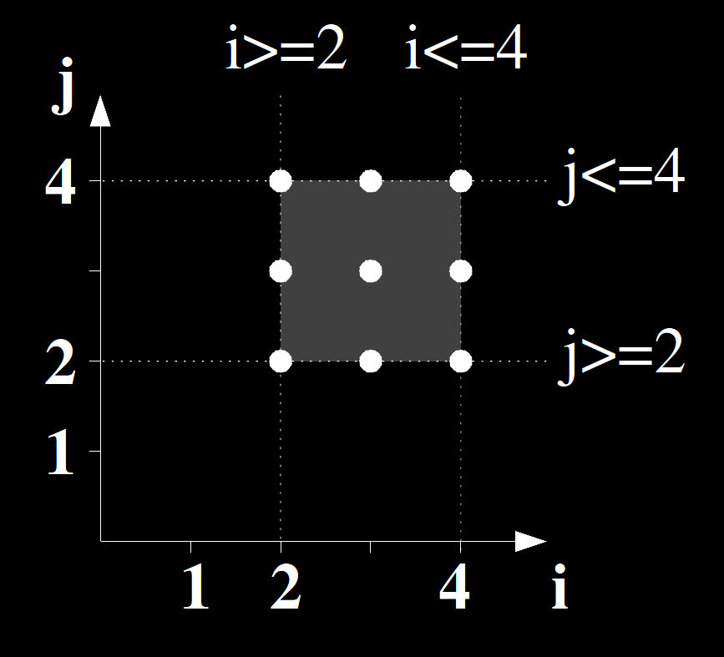
Scattering Function
Output the scheduled global logical date
$$\begin{matrix}\begin{matrix}Iteration domain \\ \begin{matrix}\begin{matrix}(2,2) \\ (2,3) \\ (2,4)\end{matrix} \\ \begin{matrix}(3,2) \\ (3,3) \\ (3,4)\end{matrix} \\ \begin{matrix}(4,2) \\ (4,3) \\ (4,4)\end{matrix}\end{matrix}\end{matrix} & \begin{matrix} \\ \begin{matrix}\begin{matrix}\left(3\right)→\left(3\right) \\ \left(3\right)→\left(3\right) \\ \left(3\right)→\left(3\right)\end{matrix} \\ \begin{matrix}\left(3\right)→\left(3\right) \\ \left(3\right)→\left(3\right) \\ \left(3\right)→\left(3\right)\end{matrix} \\ \begin{matrix}\left(3\right)→\left(3\right) \\ \left(3\right)→\left(3\right) \\ \left(3\right)→\left(3\right)\end{matrix}\end{matrix}\end{matrix} & \begin{matrix}Logical date \\ \begin{matrix}\begin{matrix}(4,8) \\ (5,9) \\ (6,10)\end{matrix} \\ \begin{matrix}(4,11) \\ (5,12) \\ (6,13)\end{matrix} \\ \begin{matrix}(4,14) \\ (5,15) \\ (6,16)\end{matrix}\end{matrix}\end{matrix}\end{matrix}$$
$$for \left(i=2;i≤4;i++\right) \\ for \left(j=2;j≤4;j++\right) \\ P\left[i+j\right]+=A\left[i\right]+B\left[j\right]; //S4$$
$$Iteration domain$$
$$\left\{\begin{matrix}2≤i≤4 \\ 2≤j≤4\end{matrix}\right.⇒\left[\begin{matrix}\begin{matrix}\begin{matrix}1 \\ −1\end{matrix} \\ \begin{matrix}0 \\ 0\end{matrix}\end{matrix} & \begin{matrix}\begin{matrix}0 \\ 0\end{matrix} \\ \begin{matrix}1 \\ −1\end{matrix}\end{matrix} & \begin{matrix}\begin{matrix}−2 \\ 4\end{matrix} \\ \begin{matrix}2 \\ 4\end{matrix}\end{matrix}\end{matrix}\right]\left(\begin{matrix}i \\ j \\ 1\end{matrix}\right)≥0$$
$$θ_{S4}\left(i,j\right)=\left(j+2, 3∗i+j\right)$$
$$θ_{S4}\left(\begin{matrix}i \\ j \\ 1\end{matrix}\right)=\left(\begin{matrix}j+2 \\ 3∗i+j\end{matrix}\right)=\left[\begin{matrix}\begin{matrix}0 \\ 3\end{matrix} & \begin{matrix}1 \\ 1\end{matrix} & \begin{matrix}2 \\ 0\end{matrix}\end{matrix}\right]\left(\begin{matrix}i \\ j \\ 1\end{matrix}\right)$$
$$Scattering function θ_{S}\left(Iteration vector\right) \\ =Scatering matrix∗Iteration vector$$

Slide 23
Scattering Matrix
A scattering matrix contains ordering information of all statement instance
CLoog can generate scheduled syntactic code from the scattering matrix
$$θ_{S4}\left(\begin{matrix}i \\ j \\ 1\end{matrix}\right)=\left[\begin{matrix}\begin{matrix}0 \\ 3\end{matrix} & \begin{matrix}0 \\ 1\end{matrix} & \begin{matrix}2 \\ 0\end{matrix}\end{matrix}\right]\left(\begin{matrix}i \\ j \\ 1\end{matrix}\right)$$
[Example] Which statement instance, $S4\left(\begin{matrix}2 \\ 3 \\ 1\end{matrix}\right)$ or $S4\left(\begin{matrix}3 \\ 2 \\ 1\end{matrix}\right)$, is executed first?
$S4\left(\begin{matrix}2 \\ 3 \\ 1\end{matrix}\right)$ is executed on logical date $θ_{S4}\left(\begin{matrix}2 \\ 3 \\ 1\end{matrix}\right)=\left[\begin{matrix}\begin{matrix}0 \\ 3\end{matrix} & \begin{matrix}1 \\ 1\end{matrix} & \begin{matrix}2 \\ 0\end{matrix}\end{matrix}\right]\left(\begin{matrix}2 \\ 3 \\ 1\end{matrix}\right)=\left(\begin{matrix}5 \\ 9\end{matrix}\right)$
$S4\left(\begin{matrix}3 \\ 2 \\ 1\end{matrix}\right)$ is executed on logical date $θ_{S4}\left(\begin{matrix}3 \\ 2 \\ 1\end{matrix}\right)=\left[\begin{matrix}\begin{matrix}0 \\ 3\end{matrix} & \begin{matrix}1 \\ 1\end{matrix} & \begin{matrix}2 \\ 0\end{matrix}\end{matrix}\right]\left(\begin{matrix}3 \\ 2 \\ 1\end{matrix}\right)=\left(\begin{matrix}4 \\ 11\end{matrix}\right)$
So, we know that $S4\left(\begin{matrix}3 \\ 2 \\ 1\end{matrix}\right)$ is executed before $S4\left(\begin{matrix}2 \\ 3 \\ 1\end{matrix}\right)$

Slide 24
Scattering Function of the Original Program
Follow the original order of the iteration variables
$$θ_{S1}\left(\begin{matrix}\begin{matrix}i \\ j\end{matrix} \\ \begin{matrix}N \\ 1\end{matrix}\end{matrix}\right)=\left(\begin{matrix}i \\ j\end{matrix}\right)=\left[\begin{matrix}\begin{matrix}\begin{matrix}1 \\ 0\end{matrix} & \begin{matrix}0 \\ 1\end{matrix}\end{matrix} & \begin{matrix}\begin{matrix}0 \\ 0\end{matrix} & \begin{matrix}0 \\ 0\end{matrix}\end{matrix}\end{matrix}\right]\left(\begin{matrix}\begin{matrix}i \\ j\end{matrix} \\ \begin{matrix}N \\ 1\end{matrix}\end{matrix}\right) \\ θ_{S2}\left(\begin{matrix}i \\ N \\ 1\end{matrix}\right)=\left(i\right)=\left[\begin{matrix}1 & 0 & 0\end{matrix}\right]\left(\begin{matrix}i \\ N \\ 1\end{matrix}\right) \\ θ_{S3}\left(\begin{matrix}\begin{matrix}i \\ j\end{matrix} \\ \begin{matrix}k \\ N \\ 1\end{matrix}\end{matrix}\right)=\left(\begin{matrix}i \\ j \\ k\end{matrix}\right)=\left[\begin{matrix}\begin{matrix}\begin{matrix}1 \\ 0 \\ 0\end{matrix} & \begin{matrix}0 \\ 1 \\ 0\end{matrix}\end{matrix} & \begin{matrix}\begin{matrix}0 \\ 0 \\ 1\end{matrix} & \begin{matrix}0 \\ 0 \\ 0\end{matrix} & \begin{matrix}0 \\ 0 \\ 0\end{matrix}\end{matrix}\end{matrix}\right]\left(\begin{matrix}\begin{matrix}i \\ j\end{matrix} \\ \begin{matrix}k \\ N \\ 1\end{matrix}\end{matrix}\right) \\ θ_{S4}\left(\begin{matrix}\begin{matrix}i \\ j\end{matrix} \\ \begin{matrix}N \\ 1\end{matrix}\end{matrix}\right)=\left(\begin{matrix}i \\ j\end{matrix}\right)=\left[\begin{matrix}1 & 0 \\ 0 & 1\end{matrix}\right]\left(\begin{matrix}\begin{matrix}i \\ j\end{matrix} \\ \begin{matrix}N \\ 1\end{matrix}\end{matrix}\right)$$
$$for \left(i=0;i≤N;i++\right)\{ \\ for (j=0;j≤i−1;j++)\{ \\ a\left[i\right]\left[i\right]−=a\left[i\right]\left[j\right]; //S1 \\ \} \\ a\left[i\right]\left[i\right]=sqrt\left(a\left[i\right]\left[i\right]\right); //S2 \\ for (j=i+1;j≤N;j++)\{ \\ for (k=1;k≤i−1;k++)\{ \\ a\left[j\right]\left[i\right]−=a\left[j\right]\left[k\right]∗a\left[i\right]\left[k\right]; //S3 \\ \} \\ a\left[j\right]\left[i\right] /=a\left[i\right]\left[i\right]; //S4 \\ \} \\ \}$$

Slide 25
Scattering Function of the Original Program
Follow the original order of the iteration variables
Schedule statements
$$θ_{S1}\left(\begin{matrix}\begin{matrix}i \\ j\end{matrix} \\ \begin{matrix}N \\ 1\end{matrix}\end{matrix}\right)=\left(\begin{matrix}i \\ 0 \\ j\end{matrix}\right)=\left[\begin{matrix}\begin{matrix}\begin{matrix}1 \\ 0 \\ 0\end{matrix} & \begin{matrix}0 \\ 0 \\ 1\end{matrix}\end{matrix} & \begin{matrix}\begin{matrix}0 \\ 0 \\ 0\end{matrix} & \begin{matrix}0 \\ 0 \\ 0\end{matrix}\end{matrix}\end{matrix}\right]\left(\begin{matrix}\begin{matrix}i \\ j\end{matrix} \\ \begin{matrix}N \\ 1\end{matrix}\end{matrix}\right) \\ θ_{S2}\left(\begin{matrix}i \\ N \\ 1\end{matrix}\right)=\left(\begin{matrix}i \\ 1\end{matrix}\right)=\left[\begin{matrix}\begin{matrix}1 \\ 0\end{matrix} & \begin{matrix}0 \\ 0\end{matrix} & \begin{matrix}0 \\ 1\end{matrix}\end{matrix}\right]\left(\begin{matrix}i \\ N \\ 1\end{matrix}\right) \\ θ_{S3}\left(\begin{matrix}\begin{matrix}i \\ j\end{matrix} \\ \begin{matrix}k \\ N \\ 1\end{matrix}\end{matrix}\right)=\left(\begin{matrix}\begin{matrix}i \\ 2\end{matrix} \\ \begin{matrix}j \\ 0 \\ k\end{matrix}\end{matrix}\right)=\left[\begin{matrix}\begin{matrix}\begin{matrix}\begin{matrix}1 \\ 0\end{matrix} \\ \begin{matrix}0 \\ 0 \\ 0\end{matrix}\end{matrix} & \begin{matrix}\begin{matrix}0 \\ 0\end{matrix} \\ \begin{matrix}1 \\ 0 \\ 0\end{matrix}\end{matrix}\end{matrix} & \begin{matrix}\begin{matrix}\begin{matrix}0 \\ 0\end{matrix} \\ \begin{matrix}0 \\ 0 \\ 1\end{matrix}\end{matrix} & \begin{matrix}\begin{matrix}0 \\ 0\end{matrix} \\ \begin{matrix}0 \\ 0 \\ 0\end{matrix}\end{matrix} & \begin{matrix}\begin{matrix}0 \\ 2\end{matrix} \\ \begin{matrix}0 \\ 0 \\ 0\end{matrix}\end{matrix}\end{matrix}\end{matrix}\right]\left(\begin{matrix}\begin{matrix}i \\ j\end{matrix} \\ \begin{matrix}k \\ N \\ 1\end{matrix}\end{matrix}\right) \\ θ_{S4}\left(\begin{matrix}\begin{matrix}i \\ j\end{matrix} \\ \begin{matrix}N \\ 1\end{matrix}\end{matrix}\right)=\left(\begin{matrix}\begin{matrix}i \\ 2\end{matrix} \\ \begin{matrix}j \\ 1\end{matrix}\end{matrix}\right)=\left[\begin{matrix}\begin{matrix}\begin{matrix}\begin{matrix}1 \\ 0\end{matrix} \\ \begin{matrix}0 \\ 0\end{matrix}\end{matrix} & \begin{matrix}\begin{matrix}0 \\ 0\end{matrix} \\ \begin{matrix}1 \\ 0\end{matrix}\end{matrix}\end{matrix} & \begin{matrix}\begin{matrix}\begin{matrix}0 \\ 0\end{matrix} \\ \begin{matrix}0 \\ 0\end{matrix}\end{matrix} & \begin{matrix}\begin{matrix}0 \\ 0\end{matrix} \\ \begin{matrix}0 \\ 0\end{matrix}\end{matrix} & \begin{matrix}\begin{matrix}0 \\ 2\end{matrix} \\ \begin{matrix}0 \\ 1\end{matrix}\end{matrix}\end{matrix}\end{matrix}\right]\left(\begin{matrix}\begin{matrix}i \\ j\end{matrix} \\ \begin{matrix}N \\ 1\end{matrix}\end{matrix}\right)$$
$$for \left(i=0;i≤N;i++\right)\{ \\ for (j=0;j≤i−1;j++)\{ \\ a\left[i\right]\left[i\right]−=a\left[i\right]\left[j\right]; //S1 \\ \} \\ a\left[i\right]\left[i\right]=sqrt\left(a\left[i\right]\left[i\right]\right); //S2 \\ for (j=i+1;j≤N;j++)\{ \\ for (k=1;k≤i−1;k++)\{ \\ a\left[j\right]\left[i\right]−=a\left[j\right]\left[k\right]∗a\left[i\right]\left[k\right]; //S3 \\ \} \\ a\left[j\right]\left[i\right] /=a\left[i\right]\left[i\right]; //S4 \\ \} \\ \}$$
0
1
2
2.0
2.1

Slide 26
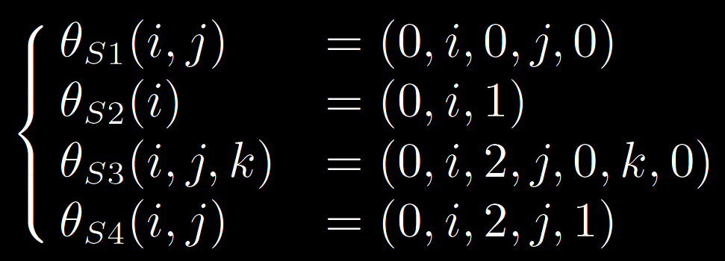
Scattering Function of the Original Program
Follow the original order of the iteration variables
Schedule statements with traditional Abstract Syntax Tree (AST)
$$for \left(i=0;i≤N;i++\right)\{ \\ for (j=0;j≤i−1;j++)\{ \\ a\left[i\right]\left[i\right]−=a\left[i\right]\left[j\right]; //S1 \\ \} \\ a\left[i\right]\left[i\right]=sqrt\left(a\left[i\right]\left[i\right]\right); //S2 \\ for (j=i+1;j≤N;j++)\{ \\ for (k=1;k≤i−1;k++)\{ \\ a\left[j\right]\left[i\right]−=a\left[j\right]\left[k\right]∗a\left[i\right]\left[k\right]; //S3 \\ \} \\ a\left[j\right]\left[i\right] /=a\left[i\right]\left[i\right]; //S4 \\ \} \\ \}$$

Slide 27
Example of Transformation – Loop Interchange
A scheduling may be an arbitrary complex sequence of basic-old-good transformations
$$Scattering function θ_{S}\left(Iteration vector\right) \\ =Scatering matrix∗Iteration vector$$
$$for \left(i=2;i≤4;i++\right) \\ for \left(j=2;j≤4;j++\right) \\ P\left[i+j\right]+=A\left[i\right]+B\left[j\right]; //S4$$
$$Original θ_{S4}\left(\begin{matrix}i \\ j \\ 1\end{matrix}\right)=\left(\begin{matrix}i \\ j\end{matrix}\right)=\left[\begin{matrix}\begin{matrix}1 \\ 0\end{matrix} & \begin{matrix}0 \\ 1\end{matrix} & \begin{matrix}0 \\ 0\end{matrix}\end{matrix}\right]\left(\begin{matrix}i \\ j \\ 1\end{matrix}\right)$$
$$\begin{matrix}\begin{matrix}Iteration domain \\ \begin{matrix}\begin{matrix}(2,2) \\ (2,3) \\ (2,4)\end{matrix} \\ \begin{matrix}(3,2) \\ (3,3) \\ (3,4)\end{matrix} \\ \begin{matrix}(4,2) \\ (4,3) \\ (4,4)\end{matrix}\end{matrix}\end{matrix} & \begin{matrix} \\ \begin{matrix}\begin{matrix}\left(3\right)→\left(3\right) \\ \left(3\right)→\left(3\right) \\ \left(3\right)→\left(3\right)\end{matrix} \\ \begin{matrix}\left(3\right)→\left(3\right) \\ \left(3\right)→\left(3\right) \\ \left(3\right)→\left(3\right)\end{matrix} \\ \begin{matrix}\left(3\right)→\left(3\right) \\ \left(3\right)→\left(3\right) \\ \left(3\right)→\left(3\right)\end{matrix}\end{matrix}\end{matrix} & \begin{matrix}Logical date \\ \begin{matrix}\begin{matrix}(2,2) \\ (3,2) \\ (4,2)\end{matrix} \\ \begin{matrix}(2,3) \\ (3,3) \\ (4,3)\end{matrix} \\ \begin{matrix}(2,4) \\ (3,4) \\ (4,4)\end{matrix}\end{matrix}\end{matrix}\end{matrix}$$
$$Loop interchange θ_{S4}\left(\begin{matrix}i \\ j \\ 1\end{matrix}\right)=\left(\begin{matrix}j \\ i\end{matrix}\right) \\ =\left[\begin{matrix}0 & 1 \\ 1 & 0\end{matrix}\right]∗Original θ_{S4}\left(\begin{matrix}i \\ j \\ 1\end{matrix}\right) \\ =\left[\begin{matrix}0 & 1 \\ 1 & 0\end{matrix}\right]∗\left[\begin{matrix}1 & 0 & 0 \\ 0 & 1 & 0\end{matrix}\right]\left(\begin{matrix}i \\ j \\ 1\end{matrix}\right)=\left[\begin{matrix}\begin{matrix}0 \\ 1\end{matrix} & \begin{matrix}1 \\ 0\end{matrix} & \begin{matrix}0 \\ 0\end{matrix}\end{matrix}\right]\left(\begin{matrix}i \\ j \\ 1\end{matrix}\right)$$
$$for \left(t1=2;t1≤4;t1++\right) \\ for \left(t2=2;t2≤4;t2++\right) \\ \{ \\ i=t2; \\ j=t1; \\ P\left[i+j\right]+=A\left[i\right]+B\left[j\right]; //S4 \\ \}$$

Slide 28
Scattering Function
Present global logical stamps of the statement instance
Ordering information inside the iteration domain
Scheduling
When the statement instance will be executed
Allocation (placement)
Which processor a statement instance has to be executed
Chunking

Slide 29
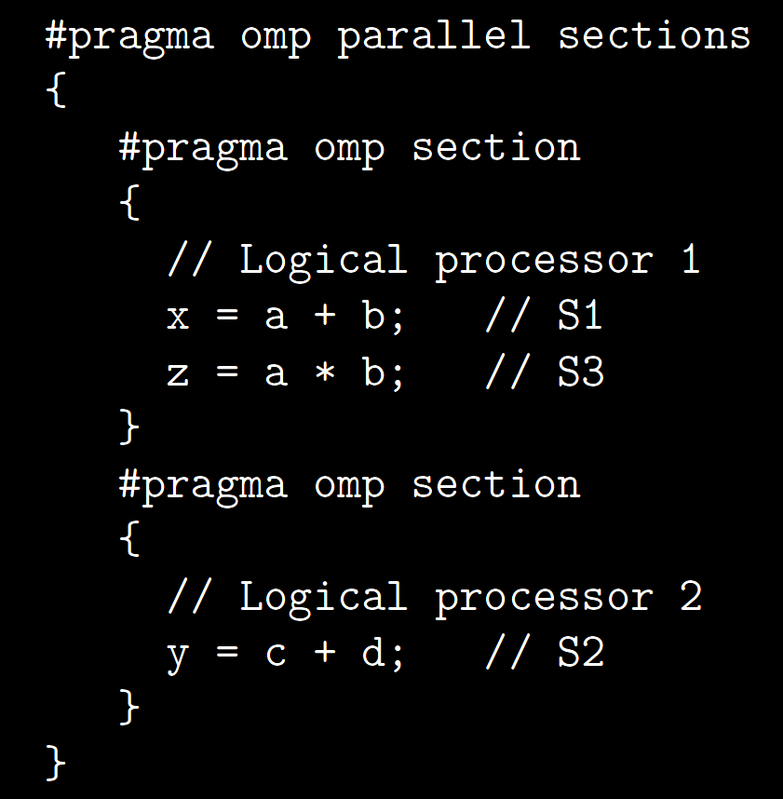
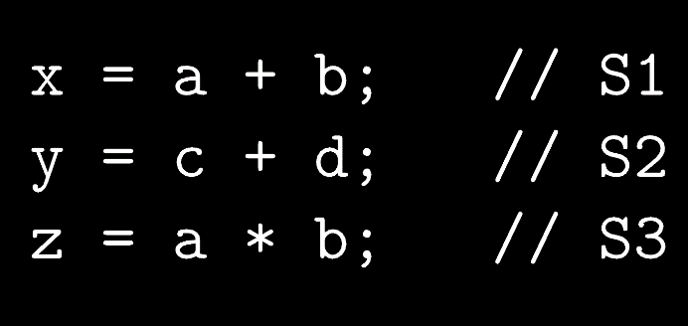
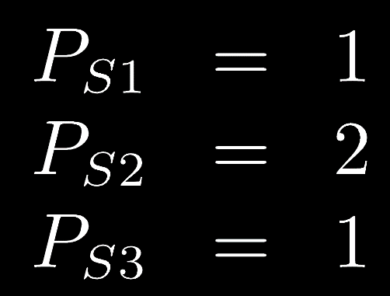
Scattering Function - Allocation
Example

Slide 30
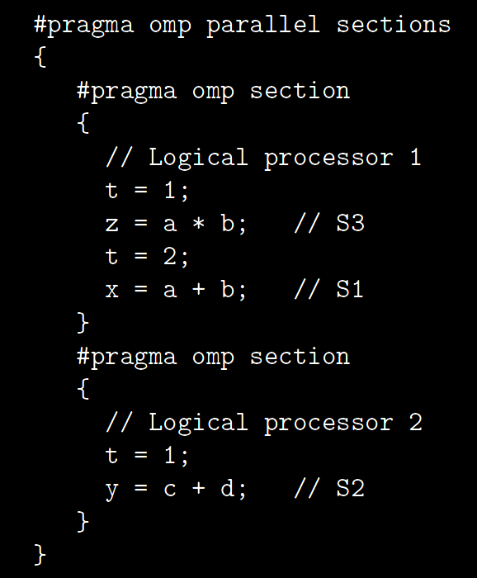
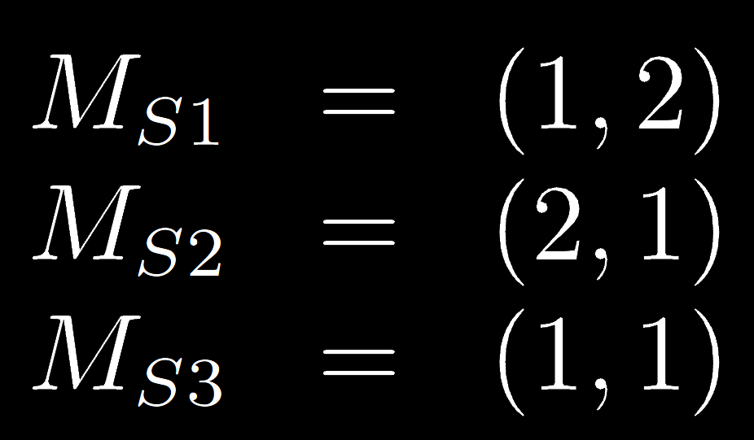
Scattering Function – Space/Time
Example

Slide 31
Polyhedral Representation
Domain matrix
Scattering matrix
Access matrixes
$$\left[\begin{matrix}\begin{matrix}\begin{matrix}\begin{matrix}1 & 0\end{matrix} & \begin{matrix}0 & −2\end{matrix}\end{matrix} \\ \begin{matrix}\begin{matrix}−1 & 0\end{matrix} & \begin{matrix}1 & 0\end{matrix}\end{matrix}\end{matrix} \\ \begin{matrix}\begin{matrix}\begin{matrix}0 & 1\end{matrix} & \begin{matrix}0 & −2\end{matrix}\end{matrix} \\ \begin{matrix}\begin{matrix}0 & −1\end{matrix} & \begin{matrix}1 & 0\end{matrix}\end{matrix}\end{matrix}\end{matrix}\right]\left(\begin{matrix}\begin{matrix}i \\ j\end{matrix} \\ \begin{matrix}N \\ 1\end{matrix}\end{matrix}\right)≥\left(\begin{matrix}\begin{matrix}0 \\ 0\end{matrix} \\ \begin{matrix}0 \\ 0\end{matrix}\end{matrix}\right)$$
$$for \left(i=0;i≤N;i++\right)\{ \\ for (j=0;j≤i−1;j++)\{ \\ a\left[i\right]\left[i\right]−=a\left[i\right]\left[j\right]; \\ \} \\ a\left[i\right]\left[i\right]=sqrt\left(a\left[i\right]\left[i\right]\right); \\ for (j=i+1;j≤N;j++)\{ \\ for (k=1;k≤i−1;k++)\{ \\ a\left[j\right]\left[i\right]−=a\left[j\right]\left[k\right]∗a\left[i\right]\left[k\right]; \\ \} \\ a\left[j\right]\left[i\right] /=a\left[i\right]\left[i\right]; \\ \} \\ \}$$
Iteration domain
$$θ\left(\begin{matrix}\begin{matrix}i \\ j\end{matrix} \\ \begin{matrix}N \\ 1\end{matrix}\end{matrix}\right)=\left[\begin{matrix}\begin{matrix}\begin{matrix}1 & 0\end{matrix} & \begin{matrix}0 & 0\end{matrix}\end{matrix} \\ \begin{matrix}\begin{matrix}0 & 1\end{matrix} & \begin{matrix}0 & 0\end{matrix}\end{matrix}\end{matrix}\right]\left(\begin{matrix}\begin{matrix}i \\ j\end{matrix} \\ \begin{matrix}N \\ 1\end{matrix}\end{matrix}\right)$$
Scattering function
$$W_{A}\left(\begin{matrix}\begin{matrix}i \\ j\end{matrix} \\ \begin{matrix}N \\ 1\end{matrix}\end{matrix}\right)=\left[\begin{matrix}\begin{matrix}\begin{matrix}1 & 0\end{matrix} & \begin{matrix}0 & 0\end{matrix}\end{matrix} \\ \begin{matrix}\begin{matrix}1 & 0\end{matrix} & \begin{matrix}0 & 0\end{matrix}\end{matrix}\end{matrix}\right]\left(\begin{matrix}\begin{matrix}i \\ j\end{matrix} \\ \begin{matrix}N \\ 1\end{matrix}\end{matrix}\right)$$
Access functions

Slide 32
Access Functions
Store the arrays (variables) access information for dependences analysis
$$for (i=0;i≤N;i++) \\ for \left(j=0;j≤N;j++\right) \\ A\left[i\right]\left[j\right]=A\left[i+1\right]\left[j−2\right]+B\left[i−1\right]\left[−j+3\right];$$
$$Iteration vector=\left(\begin{matrix}\begin{matrix}i \\ j\end{matrix} \\ \begin{matrix}N \\ 1\end{matrix}\end{matrix}\right)$$
$$WRITE_{A}\left(\begin{matrix}\begin{matrix}i \\ j\end{matrix} \\ \begin{matrix}N \\ 1\end{matrix}\end{matrix}\right)=\left(\begin{matrix}i \\ j\end{matrix}\right)=\left[\begin{matrix}\begin{matrix}\begin{matrix}1 & 0\end{matrix} & \begin{matrix}0 & 0\end{matrix}\end{matrix} \\ \begin{matrix}\begin{matrix}0 & 1\end{matrix} & \begin{matrix}0 & 0\end{matrix}\end{matrix}\end{matrix}\right]\left(\begin{matrix}\begin{matrix}i \\ j\end{matrix} \\ \begin{matrix}N \\ 1\end{matrix}\end{matrix}\right)$$
$$Access function\left(Iteration vector\right) \\ =Access matrix∗Iteration vector$$
$$READ_{A}\left(\begin{matrix}\begin{matrix}i \\ j\end{matrix} \\ \begin{matrix}N \\ 1\end{matrix}\end{matrix}\right)=\left(\begin{matrix}i+1 \\ j−2\end{matrix}\right)=\left[\begin{matrix}\begin{matrix}\begin{matrix}1 & 0\end{matrix} & \begin{matrix}0 & 1\end{matrix}\end{matrix} \\ \begin{matrix}\begin{matrix}0 & 1\end{matrix} & \begin{matrix}0 & −2\end{matrix}\end{matrix}\end{matrix}\right]\left(\begin{matrix}\begin{matrix}i \\ j\end{matrix} \\ \begin{matrix}N \\ 1\end{matrix}\end{matrix}\right)$$
$$READ_{B}\left(\begin{matrix}\begin{matrix}i \\ j\end{matrix} \\ \begin{matrix}N \\ 1\end{matrix}\end{matrix}\right)=\left(\begin{matrix}−i−1 \\ −j+3\end{matrix}\right)=\left[\begin{matrix}\begin{matrix}\begin{matrix}1 & 0\end{matrix} & \begin{matrix}0 & −1\end{matrix}\end{matrix} \\ \begin{matrix}\begin{matrix}0 & −1\end{matrix} & \begin{matrix}0 & 3\end{matrix}\end{matrix}\end{matrix}\right]\left(\begin{matrix}\begin{matrix}i \\ j\end{matrix} \\ \begin{matrix}N \\ 1\end{matrix}\end{matrix}\right)$$

Slide 33
Access Matrixes
Record the memory allocation where the statement instance access
[Example] Where the memory allocations does statement instance $S\left(\begin{matrix}1 \\ 2\end{matrix}\right)$ access?
$$WRITE_{A}\left(\begin{matrix}\begin{matrix}i \\ j\end{matrix} \\ \begin{matrix}N \\ 1\end{matrix}\end{matrix}\right)=\left[\begin{matrix}\begin{matrix}\begin{matrix}1 & 0\end{matrix} & \begin{matrix}0 & 0\end{matrix}\end{matrix} \\ \begin{matrix}\begin{matrix}0 & 1\end{matrix} & \begin{matrix}0 & 0\end{matrix}\end{matrix}\end{matrix}\right]\left(\begin{matrix}\begin{matrix}i \\ j\end{matrix} \\ \begin{matrix}N \\ 1\end{matrix}\end{matrix}\right)$$
$$→WRITE_{A}\left(\begin{matrix}\begin{matrix}1 \\ 2\end{matrix} \\ \begin{matrix}N \\ 1\end{matrix}\end{matrix}\right)=\left[\begin{matrix}\begin{matrix}\begin{matrix}1 & 0\end{matrix} & \begin{matrix}0 & 0\end{matrix}\end{matrix} \\ \begin{matrix}\begin{matrix}0 & 1\end{matrix} & \begin{matrix}0 & 0\end{matrix}\end{matrix}\end{matrix}\right]\left(\begin{matrix}\begin{matrix}1 \\ 2\end{matrix} \\ \begin{matrix}N \\ 1\end{matrix}\end{matrix}\right)=\left(\begin{matrix}1 \\ 2\end{matrix}\right)$$
$$READ_{A}\left(\begin{matrix}\begin{matrix}i \\ j\end{matrix} \\ \begin{matrix}N \\ 1\end{matrix}\end{matrix}\right)=\left[\begin{matrix}\begin{matrix}\begin{matrix}1 & 0\end{matrix} & \begin{matrix}0 & 1\end{matrix}\end{matrix} \\ \begin{matrix}\begin{matrix}0 & 1\end{matrix} & \begin{matrix}0 & −2\end{matrix}\end{matrix}\end{matrix}\right]\left(\begin{matrix}\begin{matrix}i \\ j\end{matrix} \\ \begin{matrix}N \\ 1\end{matrix}\end{matrix}\right)$$
$$→READ_{A}\left(\begin{matrix}\begin{matrix}1 \\ 2\end{matrix} \\ \begin{matrix}N \\ 1\end{matrix}\end{matrix}\right)=\left[\begin{matrix}\begin{matrix}\begin{matrix}1 & 0\end{matrix} & \begin{matrix}0 & 1\end{matrix}\end{matrix} \\ \begin{matrix}\begin{matrix}0 & 1\end{matrix} & \begin{matrix}0 & −2\end{matrix}\end{matrix}\end{matrix}\right]\left(\begin{matrix}\begin{matrix}1 \\ 2\end{matrix} \\ \begin{matrix}N \\ 1\end{matrix}\end{matrix}\right)=\left(\begin{matrix}2 \\ 0\end{matrix}\right)$$
$$READ_{B}\left(\begin{matrix}\begin{matrix}i \\ j\end{matrix} \\ \begin{matrix}N \\ 1\end{matrix}\end{matrix}\right)=\left[\begin{matrix}\begin{matrix}\begin{matrix}1 & 0\end{matrix} & \begin{matrix}0 & −1\end{matrix}\end{matrix} \\ \begin{matrix}\begin{matrix}0 & −1\end{matrix} & \begin{matrix}0 & 3\end{matrix}\end{matrix}\end{matrix}\right]\left(\begin{matrix}\begin{matrix}i \\ j\end{matrix} \\ \begin{matrix}N \\ 1\end{matrix}\end{matrix}\right)$$
$$→READ_{B}\left(\begin{matrix}\begin{matrix}1 \\ 2\end{matrix} \\ \begin{matrix}N \\ 1\end{matrix}\end{matrix}\right)=\left[\begin{matrix}\begin{matrix}\begin{matrix}1 & 0\end{matrix} & \begin{matrix}0 & −1\end{matrix}\end{matrix} \\ \begin{matrix}\begin{matrix}0 & −1\end{matrix} & \begin{matrix}0 & 3\end{matrix}\end{matrix}\end{matrix}\right]\left(\begin{matrix}\begin{matrix}1 \\ 2\end{matrix} \\ \begin{matrix}N \\ 1\end{matrix}\end{matrix}\right)=\left(\begin{matrix}0 \\ 1\end{matrix}\right)$$
$S\left(\begin{matrix}1 \\ 2\end{matrix}\right)$ writes $A\left[1\right]\left[2\right]$, reads $A\left[2\right]\left[0\right]$ and $B\left[0\right]\left[1\right]$

Slide 34
Summary
Key aspect of the polyhedral model is to consider each statement instance by $Iteration vector$
Each statement represented by three matrixes
$Domain matrix∗Iteration vector≥0$
All possible statement instances
$Scattering function θ_{S}\left(Iteration vector\right)$ $=Scatering matrix∗Iteration vector$
Scheduling result between statement instances
$Access function\left(Iteration vector\right)$ $=Access matrix∗Iteration vector$
Memory access information of statement instances

Slide 35
Reference
Basics of Affine Geometry - http://www.cis. upenn.edu/~cis610/geombchap2.pdf
Clan - http://icps.u-strasbg.fr/people/bastoul/ public_html/development/clan/
Openscop - http://icps.u-strasbg.fr/~bastoul/ development/openscop/
Cédric Bastoul and Paul Feautrier, “Improving data locality by chunking”, 2003
Cédric Bastoul, Albert Cohen, Sylvain Girbal, Saurabh Sharma, and Olivier Temam, “Putting Polyhedral Loop Transformations to Work”, 2012

Slide 36
Thank you for listening

