Slide 1
Crosstalk-aware TSV-buffer Insertion in 3D IC
Yen-Hao Chen, Po-Chen Huang, Fu-Wei Chen, Allen C.-H. Wu, and TingTing Hwang
Department of Computer Science National Tsing Hua University Taiwan

Slide 2
Outline
Three-dimensional integrated Circuit (3D IC)
Crosstalk effect problem
Difference between 3D IC and 2D IC
Overall global flow
Problem formulation
TSV-buffer sizing problem
Detailed TSV crosstalk delay model
Methodology
Integer linear programming (ILP)
Crosstalk-aware heuristic (CAH)
Experimental results
Comparison on CAH and ILP
Comparison on CAH and other heuristics
Conclusions
Notes:
This is the outline.
First, we are going to discuss about the three-dimensional integrated circuit (3D IC) and the crosstalk effect between 3D IC and 2D IC.
Then, the problem formulation will be given.
We will present our methodologies, including ILP and crosstalk-aware heuristic method.
And, finally, the experimental results and conclusions.
Let start with the three-dimensional integrated circuits

Slide 3
Three-dimensional Integrated Circuit (3D IC)
Interconnection delay is a dominant factor of ICs
3D IC can alleviate interconnection delay
Across dies by through-silicon via (TSV)
TSV
TSV
TSV
Notes:
In the three-dimensional integrated circuit, the interconnection delay is a dominant factor if ICs.
The 3D IC can alleviate the interconnection delay by through-silicon vias.

Slide 4
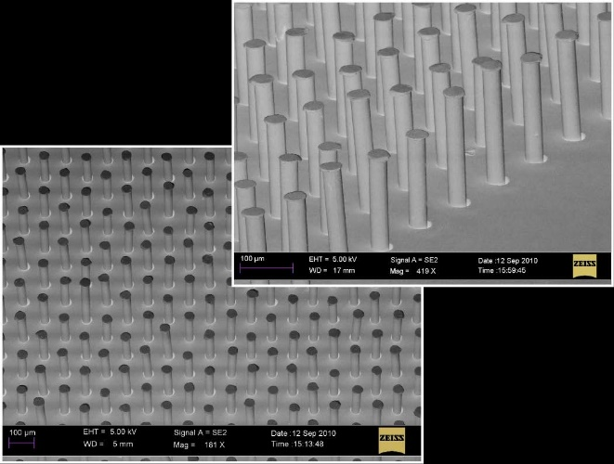
TSV Block
TSVs are usually bundled together for yield [1]
Result in serious crosstalk effect between TSVs
TSV
TSV block
…
…
A. C. Fischer, N. Roxhed, T. Haraldsson, N. Heinig, G. Stemme and F. Niklaus, "Fabrication of high aspect ratio through silicon vias (TSVs) by magnetic assembly of nickel wires," 2011 IEEE 24th International Conference on Micro Electro Mechanical Systems, Cancun, 2011, pp. 37-40.
Notes:
TSVs are usually bundled together into an array for yield rate.
However, this placement will result in serious crosstalk effect between TSVs.

Slide 5
Outline
Three-dimensional integrated Circuit (3D IC)
Crosstalk effect problem
Difference between 3D IC and 2D IC
Overall global flow
Problem formulation
TSV-buffer sizing problem
Detailed TSV crosstalk delay model
Methodology
Integer linear programming (ILP)
Crosstalk-aware heuristic (CAH)
Experimental results
Comparison on CAH and ILP
Comparison on CAH and other heuristics
Conclusions

Slide 6
Crosstalk Effect
Crosstalk effect of TSV is much larger than wire
Up to 31.12% timing degradation
2D crosstalk model
Wire
$$\frac{C_{coup}}{2}$$
$$\frac{C_{gnd}}{2}$$
$$R_{wire}$$
3D crosstalk model
TSV
TSV
$$C_{tsv}$$
$$C_{si}$$
$$R_{tsv}$$
$$L_{tsv}$$
$$R_{si}$$
Notes:
By the SIPCE simulation, the crosstalk effect of TSV is much larger than the wire.
Overall, the crosstalk effect may result in up to 31% timing degradation.

Slide 7
Down-sizing TSV-buffer
2D IC’s crosstalk effect can be solved easily
Up-sizing buffer of wire to resolve timing violation
TSVs in TSV block affect each other significantly
Sized-buffer may become a serious aggressor
Down-size may be the right path to solve timing
Tight timing path
Up-sizing
4x
TSV block
4x
8x
8x
Still timing violation!!
Timing violated path
4x
4x
4x
4x
8x
4x
2x
Not only satisfy timing but also reduce area
2x
4x
8x
Non-critical paths
Down-sizing
2x
Notes:
In 2D IC, the crosstalk effect is usually small and can be solved easily by up-sizing the buffer of victim to resolve timing violation.
However, for the TSVs in the TSV block, each TSV affect each other significantly.
A sized-buffer may become another serious aggressor affecting others.
Down-sizing may be the right path to solve timing.
For example, the figure is showing a TSV block, where the TSV in the middle has timing violation.
And the TSV next to it has a tight timing.
The others are on non-critical paths.
If we up-sizing the TSV in the middle, it may become an aggressor to the TSV next to it, and make the neighboring TSV become timing violation.
In this case, a better solution could be down-sizing the non-critical TSVs.
Thus, not only the timing is satisfied, but also the overall area is reduced.

Slide 8
Outline
Three-dimensional integrated Circuit (3D IC)
Crosstalk effect problem
Difference between 3D IC and 2D IC
Overall global flow
Problem formulation
TSV-buffer sizing problem
Detailed TSV crosstalk delay model
Methodology
Integer linear programming (ILP)
Crosstalk-aware heuristic (CAH)
Experimental results
Comparison on CAH and ILP
Comparison on CAH and other heuristics
Conclusions

Slide 9
Overall Global Flow
Input circuit
3D partitioning / floorplanning
TSV block allocation / assignment
TSV-buffer insertion / initialization
Timing optimization by TSV-buffer sizing
Timing constraint satisfied?
Timing failure
Output circuit
Notes:
This is our global flow.
Given an input circuit.
3D partitioning and floorplanning will performed.
Then, TSV block allocation and assignment.
After that, TSV-buffer insertion and initialization.
Then, our focused timing optimization by TSV-buffer sizing solver.
And finally, we will check whether the timing constraints are satisfied and report the result.

Slide 10
Outline
Three-dimensional integrated Circuit (3D IC)
Crosstalk effect problem
Difference between 3D IC and 2D IC
Overall global flow
Problem formulation
TSV-buffer sizing problem
Detailed TSV crosstalk delay model
Methodology
Integer linear programming (ILP)
Crosstalk-aware heuristic (CAH)
Experimental results
Comparison on CAH and ILP
Comparison on CAH and other heuristics
Conclusions

Slide 11
One-hot Encoding
Represent TSV-buffer sizes
Linear formula
Matrix form
Given TSV $t$, binary variable $n_{s}^{t}$ is 1 if and only if the TSV $t$ uses an $s$-sized TSV-buffer
$$SIZE=\left\{2x,4x,8x\right\}$$
Buffer area of TSV $t$
$$\sum_{s∈SIZE}{{area}_{s}×n_{s}^{t}}=\left[\begin{matrix}{area}_{2x} & {area}_{4x} & {area}_{8x}\end{matrix}\right]×\left[\begin{matrix}n_{2x}^{t} \\ n_{4x}^{t} \\ n_{8x}^{t}\end{matrix}\right]$$
Buffer size of TSV $t$
$$\left[\begin{matrix}n_{2x}^{t} \\ n_{4x}^{t} \\ n_{8x}^{t}\end{matrix}\right]$$
$$=\left[\begin{matrix}0 \\ 1 \\ 0\end{matrix}\right]$$
$$=\left[\begin{matrix}1 \\ 0 \\ 0\end{matrix}\right]$$
$$=\left[\begin{matrix}0 \\ 0 \\ 1\end{matrix}\right]$$
Area of $s$-sized TSV-buffer (predefined constant value)
$2x$-sized
$4x$-sized
$8x$-sized
Notes:
In this work, we use the one-hot encoding to represent sizes of TSV-buffers.
Because it is easy to model the buffer-sizing problem for the linear formula and matrix form.
We defined that given a TSV t, the binary variables nts is 1 if and only if the TSV t uses and s-sized TSV-buffer.
For example, assume that there are three available TSV sizes, namely 2x, 4x, and 8x.
The buffer-size of TSV t and be denoted as a vector form.
For instance, this indicates the TSV is using a 2x-sized buffer.
And, this indicates the TSV is using a 4x-sized buffer.
And lastly, this indicates the TSV is using an 8x-sized buffer.
With the representation, the buffer area of TSV t can be denoted as the linear equation, where the area-s is the area of s-sized TSV-buffer which is a predefined constant value.

Slide 12
TSV-buffer Sizing Problem
Objective: minimize total TSV-buffer area
Such that: satisfy timing constraint on outputs
Node delay is max. predecessor and edge delays
$$\min{\sum_{t∈TSV}{\sum_{s∈SIZE}{area_{s}×n_{s}^{t}}}}$$
$$out_{1}$$
(Primary output)
$$delay\left(out\right)≤timing_constraint, \\ ∀out∈Primary_outputs$$
$$out_{2}$$
(Primary output)
$$delay\left(n\right)=\max_{p∈pred_{n}}\left(delay\left(p\right)+edge_delay\left(p,n\right)+node_delay\left(n\right)\right)$$
$$p_{0}$$
$$p_{1}$$
$$n$$
$$p_{2}$$
Notes:
Thus, the TSV-buffer sizing problem can be formulated as minimize the total TSV-buffer area with the equation.
And, the timing constraint is satisfied on primary outputs.
Also, the node delay is the maximum of the predecessor and edge delays.

Slide 13
Outline
Three-dimensional integrated Circuit (3D IC)
Crosstalk effect problem
Difference between 3D IC and 2D IC
Overall global flow
Problem formulation
TSV-buffer sizing problem
Detailed TSV crosstalk delay model
Methodology
Integer linear programming (ILP)
Crosstalk-aware heuristic (CAH)
Experimental results
Comparison on CAH and ILP
Comparison on CAH and other heuristics
Conclusions

Slide 14
SPICE Simulation
Comprehensive SPICE simulation is performed
Worst case transition scenario
2D crosstalk model
Wire
$$\frac{C_{coup}}{2}$$
$$\frac{C_{gnd}}{2}$$
$$R_{wire}$$
3D crosstalk model
TSV
TSV
$$C_{tsv}$$
$$C_{si}$$
$$R_{tsv}$$
$$L_{tsv}$$
$$R_{si}$$
Notes:
A comprehensive SPICE simulation was performed, and the worst case transition scenario is considered.

Slide 15
Detailed TSV Crosstalk Delay Model
$Delay_Table\left(size^{v},SIZE^{a}\right)$ record SPICE results
Consider four neighboring TSVs
Neighboring TSVs contribute most crosstalk effect [5-8]
(Aggressor sizes)
(Victim size)
Victim
2x
Victim
Victim
…
2x
4x
2x
4x
4x
2x
4x
4x
Aggressor
8x
Aggressors
Aggressors
Notes:
We record the SPICE simulation result into a data structure call the delay table.
The four most nearing TSVs are considered, because the nearby TSVs contribute most of the crosstalk effect.
The delay table is partially shown on the slide.
For example, if a victim TSV with 4x-sized buffer nearby an aggressor TSV with 2x-sized buffer, the delay of the victim TSV is 221 ps.
Also, if a victim TSV with 4x-sized buffer nearby two aggressor TSVs with 2x- and 4x-sized buffers, the victim TSV has a delay 313 ps.
And lastly, if a victim TSV is surrounded by 4 aggressor TSVs with two 2x-sized, one 4x-sized, and one 8x-sized buffers, the victim TSV has a delay 517 ps.

Slide 16
Outline
Three-dimensional integrated Circuit (3D IC)
Crosstalk effect problem
Difference between 3D IC and 2D IC
Overall global flow
Problem formulation
TSV-buffer sizing problem
Detailed TSV crosstalk delay model
Methodology
Integer linear programming (ILP)
Crosstalk-aware heuristic (CAH)
Experimental results
Comparison on CAH and ILP
Comparison on CAH and other heuristics
Conclusions

Slide 17
Linear Delay Function
$TSV_delay\left(v\right)$: approx. linear TSV delay function
Detailed delay model of TSVs is non-linear
TSV
$$TSV_delay\left(v\right)=\sum_{s∈SIZE}{resis_{s}^{0}×n_{s}^{v}}$$
$$v$$
Constant values
Victim
$$TSV_delay\left(v\right) \\ =\sum_{s∈SIZE}{resis_{s}^{N_aggs}×n_{s}^{v}}+\sum_{i=1}^{N_aggs}{\sum_{s∈SIZE}{{cross}_{s}^{N_aggs}×n_{s}^{a_{i}}}}$$
$$v$$
Aggressors
$N_aggs$: #aggressors
Notes:
To apply the ILP, an approximated linear TSV delay model is required.
For example, if the TSV has no others nearby it. Then, the delay can be denoted as the linear equation shown on the slide.
If the victim TSV is surrounded by other aggressor TSVs. Then, the delay can be also denoted by the linear equation, where the Nagg is the number of aggressor TSVs.
Please notice that those highlighted variable are the linear constant values.

Slide 18
Obtain Constant Values
Find constants s.t. minimize difference between:
By linear regression method (least squares)
$$Delay_Table$$
$$TSV_delay\left(v\right) \\ =\sum_{s∈SIZE}{resis_{s}^{N_aggs}×n_{s}^{v}}+\sum_{i=1}^{N_aggs}{\sum_{s∈SIZE}{{cross}_{s}^{N_aggs}×n_{s}^{a_{i}}}}$$
$$\arg{\min\left(\sum_{\begin{aligned}{size}^{v} \\ {SIZE}^{a}\end{aligned}}{{\left(TSV_delay\left(v\right)−Delay_Table\left(size^{v},SIZE^{a}\right)\right)}^{2}}\right)}=\arg{\min\left({\left(n^{T}d−D\right)}^{2}\right)} \\ Let \frac{∂}{∂d}{\left(n^{T}d−D\right)}^{2}=0⇒d={\left(nn^{T}\right)}^{−1}nD \\ where n=\left[\begin{matrix}\begin{matrix}… \\ … \\ …\end{matrix} & \begin{matrix}n_{s_{1}}^{v} \\ n_{s_{2}}^{v} \\ …\end{matrix} & \begin{matrix}… \\ … \\ …\end{matrix} \\ \begin{matrix}… \\ … \\ …\end{matrix} & \begin{matrix}{N_aggs}_{s_{1}}^{v} \\ {N_aggs}_{s_{2}}^{v} \\ …\end{matrix} & \begin{matrix}… \\ … \\ …\end{matrix}\end{matrix}\right],d=\left[\begin{matrix}\begin{matrix}{resis}_{s_{1}}^{N_aggs} \\ {resis}_{s_{2}}^{N_aggs} \\ …\end{matrix} \\ \begin{matrix}{cross}_{s_{1}}^{N_aggs} \\ {cross}_{s_{2}}^{N_aggs} \\ …\end{matrix}\end{matrix}\right],and D=\left[\begin{matrix}… \\ Delay_Table\left(size^{v},SIZE^{a}\right) \\ …\end{matrix}\right]$$
The maximum error rate of the obtained linear equations is only 4.27%
Notes:
So, we want to obtain the linear constants such that the difference between the delay table by the SPICE simulation and the linear TSV delay function is minimized.
We use the linear regression method, or the least squares.
The equation is shown on the slide.
If we defined the matrix notation, it can be rewrite into matrix form.
And the optimal solution can be found by taking the first derivative, and letting it be zero.
The maximum error rate of the obtained linear equation is only 4.27%.

Slide 19
Integer Linear Equations
Linear equations is derived with $TSV_delay\left(n\right)$
Minimize total TSV-buffer area
With timing constraint
$$\min{\sum_{t∈TSV}{\sum_{s∈SIZE}{{area}_{s}×n_{s}^{t}}}}$$
$$timing_constraint≥{delay}_{n} \\ ≥{delay}_{p}+{edge_delay}_{p,n}+TSV_delay\left(n\right) \\ ≥0,∀n,∀p∈pred_{n}$$
Notes:
Thus, the linear equation can be derived with the obtained linear TSV delay function with minimizing total TSV-buffer area and timing constraints.

Slide 20
Outline
Three-dimensional integrated Circuit (3D IC)
Crosstalk effect problem
Difference between 3D IC and 2D IC
Overall global flow
Problem formulation
TSV-buffer sizing problem
Detailed TSV crosstalk delay model
Methodology
Integer linear programming (ILP)
Crosstalk-aware heuristic (CAH)
Experimental results
Comparison on CAH and ILP
Comparison on CAH and other heuristics
Conclusions
Notes:
Since ILP has its limitation on large circuits, we are going to present another crosstalk-aware heuristic method.

Slide 21
Min-cut Method
Min-cut method is widely used in 2D buffer sizing
Path timing is improved by up-sizing min-cut set
Graph of min-cut not consider physical location
Neighboring TSVs may be up-sized together
Massive crosstalk effect
Incorrect timing estimation
We don’t want that!
Critical path
TSV block
Min-cut
They are neighbors!! Serious crosstalk effect!!
Notes:
2D buffer sizing problem conventionally adopts the min-cut method.
However, the graph model does not consider the crosstalk effect due to the difficulty to model the TSV physical locations on the graph and result in incorrect timing estimation for the min-cut method.
For example, the figure shown the critical path graph model, and the min-cut method may find a min-cut as showing in the figure.
However, those two TSVs may actually physically next to each other.
It results in incorrect timing estimation.

Slide 22
Heuristic Flow Diagram
Input
Yes
Timing constraint satisfied?
Crosstalk-aware refinement
No
Graph modeling
Graph transformation
Padding node insertion
Crosstalk exclusive selection
Output
Min-cut algorithm
Deal with crosstalk effect
Upsizing min-cut set
Notes:
This is the flow of our method.
At the beginning, we check whether the timing constraint is satisfied.
If not, the we will start our crosstalk-aware graph modeling, and apply the min-cut method.
The steps iterated until the timing constraints are satisfied.
Then, the crosstalk-aware refinement is performed to further reduce area, and output the result.
The crosstalk exclusive selection and the crosstalk-aware refinement steps deal with crosstalk effect.
We not start with the crosstalk-aware graph modeling.

Slide 23
Graph Modeling – Graph Transformation
Remove unsizable nodes
Without loss of generality
Easier to apply min-cut algorithm
Each node represent a sizable TSV-buffer
4
4
2
2
3
2
3
2
3
2
2
3
Unsizable node
Notes:
The first step of our graph modeling is the graph transformation.
We remove the unsizable nodes.
In this step, the graph model is equivalent to the original graph with less number of nodes.
And more importantly, the new graph will be easier to apply the min-cut method, because each node represents a valid buffer sizing candidate.
The figure is showing an example.

Slide 24
Graph Modeling – Padding Node Insertion
Y. Tamiya proposed to insert padding nodes [3]
Achieve better solution
If an edge has input node with larger timing slack than output node, then a zero cost padding node is inserted in the edge
Input node
Output node
Input node
Output node
Zero cost padding node
Notes:
The second step of our graph modeling is the padding node insertion.
By the previous work, inserting the padding node can achieve a better result.
Thus, we follow their findings. If an edge has an input node with larger timing slack than the output node, then a zero cost padding node is inserted in the edge.

Slide 25
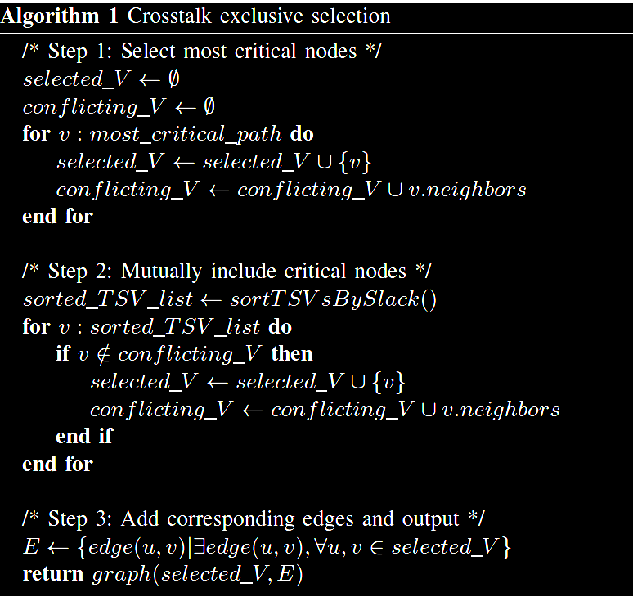
Graph Modeling – Crosstalk Exclusive Selection
Critical path
Neighbors
Notes:
The last step of our graph modeling is the crosstalk excusive selection.
There are three main steps.
The first step is the selection the most critical nodes, and remark the nearby TSVs or conflicting nodes.
Then, mutually include the critical nodes, also remark the nearby TSVs or conflict nodes.
Lastly, we add the corresponding edges and output the graph.

Slide 26
Heuristic Flow Diagram
Input
Yes
Timing constraint satisfied?
Crosstalk-aware refinement
No
Graph modeling
Graph transformation
Padding node insertion
Crosstalk exclusive selection
Output
Min-cut algorithm
Upsizing min-cut set
Notes:
Again the is the flow diagram.
Next, we are going to discuss the crosstalk-aware refinement.

Slide 27
Crosstalk-aware Refinement
Down-sizing may improve timing of neighbors
Crosstalk effect of TSVs affect timing significantly
Down-size oversized TSV-buffer
Inject random permutation
Further reduce area on a valid circuit
4x
2x
Not only satisfy timing but also reduce area
4x
4x
8x
2x
4x
8x
Down-sizing
4x
2x
Timing violation
Critical TSV
Notes:
As mentioned earlier, down-sizing may improve the timing of neighboring TSVs.
Because the crosstalk effect of TSVs is more critical than in 2D wires.
Thus, in this step, we down-size oversized TSV-buffers and inject random permutations to further reduce the area on a valid circuit.

Slide 28
Outline
Three-dimensional integrated Circuit (3D IC)
Crosstalk effect problem
Difference between 3D IC and 2D IC
Overall global flow
Problem formulation
TSV-buffer sizing problem
Detailed TSV crosstalk delay model
Methodology
Integer linear programming (ILP)
Crosstalk-aware heuristic (CAH)
Experimental results
Comparison on CAH and ILP
Comparison on CAH and other heuristics
Conclusions
Notes:
Experimental results.
Next, we are going to compare the crosstalk-aware heuristic method with integer linear programming method, and compare proposed crosstalk-aware heuristic and other heuristic methods.

Slide 29
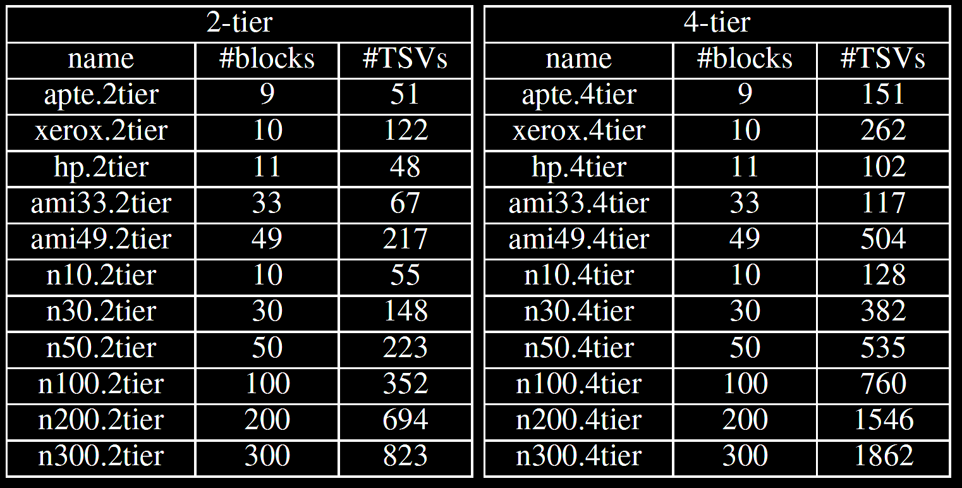
Methodology
Implemented in C/C++ language
Executed on AMD CPU with 32GB memory
GSRC and MCNC as benchmark circuits
Partitioned into 2-tier and 4-tier 3D ICs
Notes:
We implemented our method in C++ language and executed on a system with 32G memory.
The benchmark circuits are partitioned into 2-tier and 4-tier.
The table is our benchmark circuits.

Slide 30
Compare CAH with ILP
ILP require extraordinary memory space
Only small circuits can be completed by ILP
9 out of 11 on 2-tier
5 out of 11 on 4-tier
CAH obtain solutions with reasonable resources
Solutions by CAH and ILP have a similar area
2.56% on 2-tier
3.05% on 4-tier
Notes:
First, we compare our crosstalk-aware heuristic with ILP.
By the experiment, ILP requires extraordinary memory space, and only 9 out of 11 2-tier benchmark circuits and 5 out of 11 4-tier benchmark circuits is completed by the ILP method
The crosstalk-aware heuristic method, on the other hand, obtain good solutions with reasonable resource.
It has only 2.56% and 3.05% on 2-tier and 4-tier benchmark circuits.

Slide 31
Compare CAH with Other Heuristics
CAH outperform others with more area reduction
Compared to greedy [2] and separator sets [3]
32.88% and 18.21% on 2-tier
42.40% and 23.06% on 4-tier
Notes:
Compared with the other heuristic methods, our crosstalk-aware heuristic outperforms greedy and separator sets methods.
It has 32.88% and 18.21% on 2-tier benchmark circuits and 42.40% and 23.06% on 4-tier benchmark circuits.

Slide 32
Outline
Three-dimensional integrated Circuit (3D IC)
Crosstalk effect problem
Difference between 3D IC and 2D IC
Overall global flow
Problem formulation
TSV-buffer sizing problem
Detailed TSV crosstalk delay model
Methodology
Integer linear programming (ILP)
Crosstalk-aware heuristic (CAH)
Experimental results
Comparison on CAH and ILP
Comparison on CAH and other heuristics
Conclusions

Slide 33
Conclusions
TSVs suffer more crosstalk effect than wires
Cause large timing degradation in circuit paths
TSV-buffer sizing methods are proposed
Integer linear programming (ILP)
Crosstalk-aware heuristic (CAH)
CAH obtain solutions with reasonable resources
Only 3% more area compared to ILP
Up to 23% less area compared to previous works
Notes:
TSVs suffer more crosstalk effect than wires.
That causes large timing degradation on 3D ICs
TSV-buffer sizing methods are proposed to deal with the problem, including the integer linear programming and the crosstalk-aware heuristic methods.
By our experimental results, the crosstalk-aware heuristic can obtain solutions with reasonable resources.
And, it has only 3% more area compared to the ILP, and up to 23% less area compared to other heuristic methods.

Slide 34
Thank You

